Slide 1

AI-Powered Object Detection using YOLOv8
Computer Vision Project
Epsilon AI Diploma
Karim Deheya

Slide 2
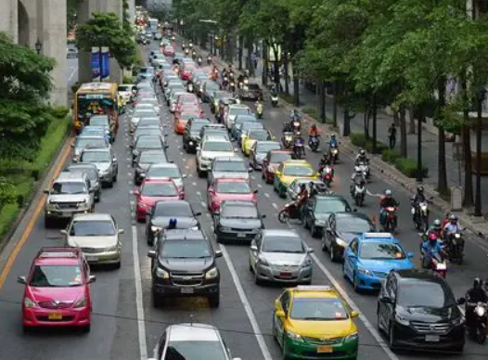
Problem Statement
Content:
Manual object detection is slow
Real-time detection is required in many applications
Need accurate AI model for multiple object classes

Slide 3
Project Objectives
Build end-to-end object detection system
1
Train YOLOv8 models
2
Compare scratch vs transfer learning vs fine-tuning
3
Deploy using Streamlit
4

Slide 4
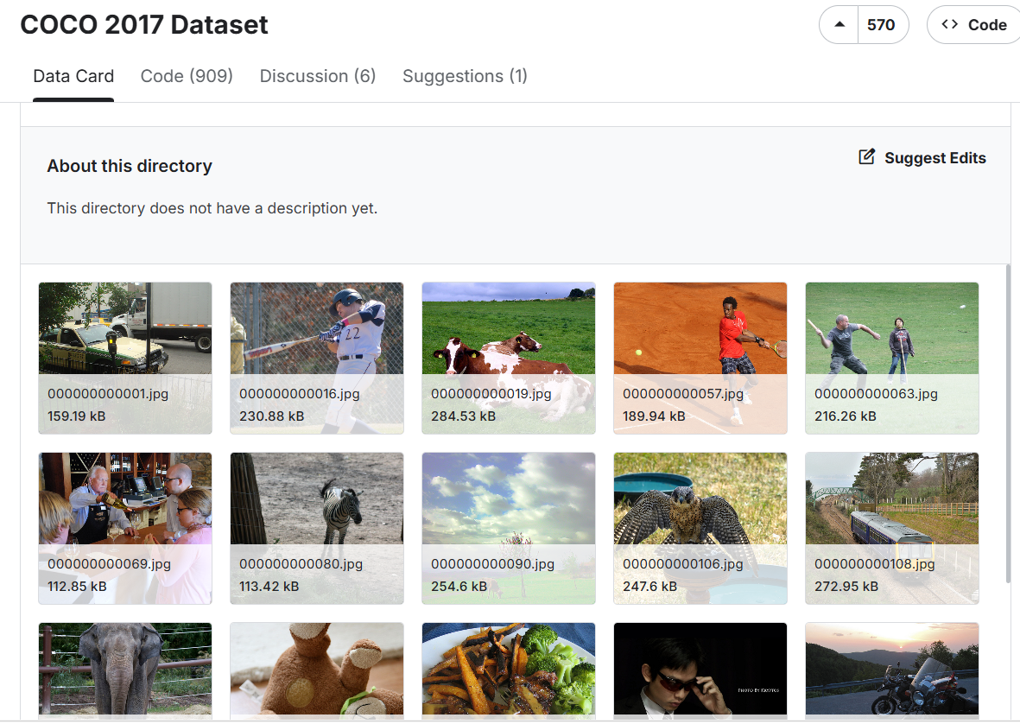
Dataset Overview
Source Dataset: COCO 2017
118,000+ training images
5,000+ validation images
80 object categories
Additional manually labeled Roboflow images
Hybrid dataset with automatic and manual annotations

Slide 5
Exploratory Data Analysis
Class imbalance exists between categories
Objects appear in different scales and sizes
Real-world backgrounds and occlusions
Different lighting conditions
Minor annotation noise due to mixed labeling sources

Slide 6
Data Preparation Pipeline

Slide 7
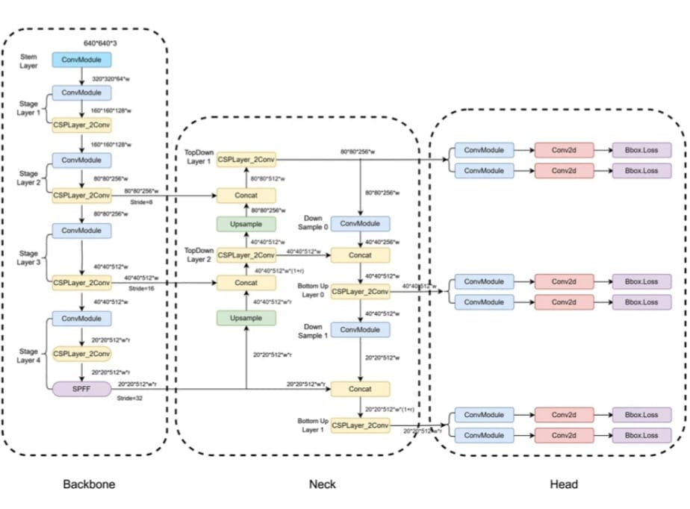
Model Architecture
YOLOv8 Architecture
Real-time object detection model
Bounding box regression
Object classification
Fast inference performance
Optimized for deployment

Slide 8
Training Strategies
Model | Method | Epochs
Model 1 | From Scratch | 5
Model 2 | Transfer Learning | 20
Model 3 | Fine-Tuning | 10

Slide 9
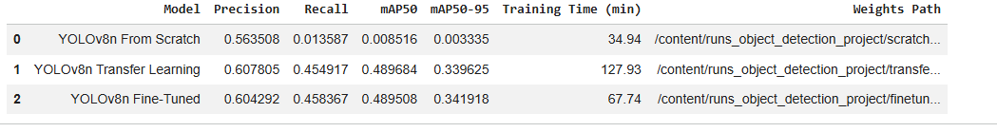
Performance Comparison

Slide 10
Best Model Selection
Fine-Tuned YOLOv8 achieved the best performance
Reasons:
Higher precision
Better recall
Improved mAP score
Better generalization

Slide 11
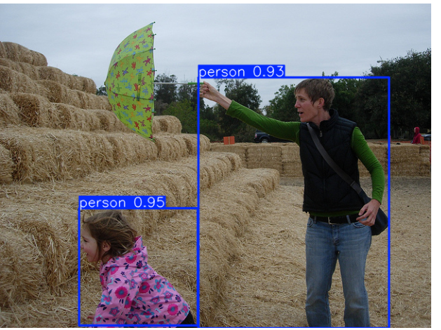
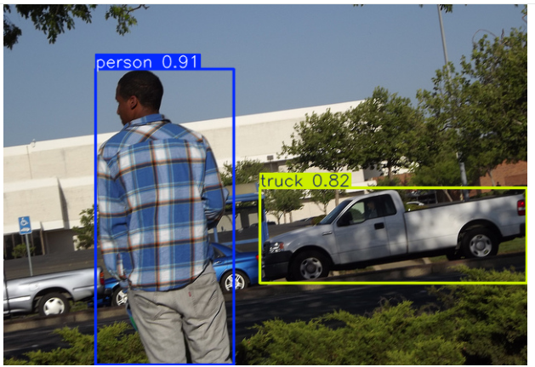
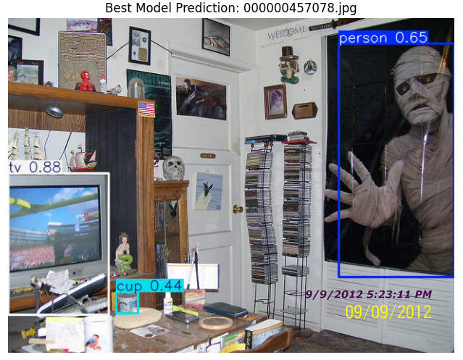
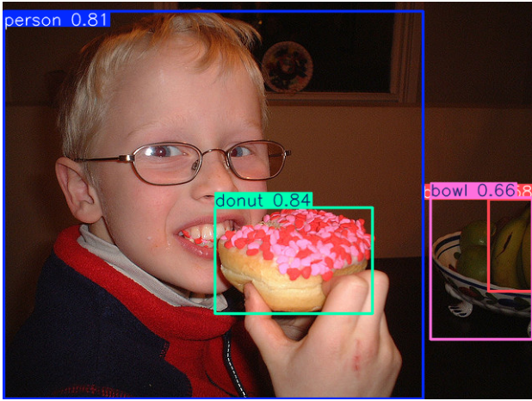
Model predictions/Results

Slide 12
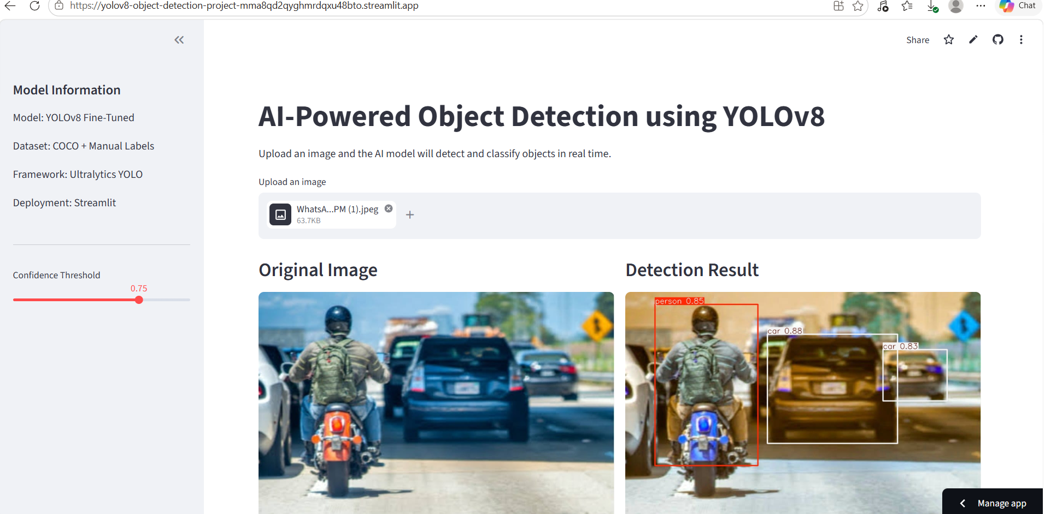
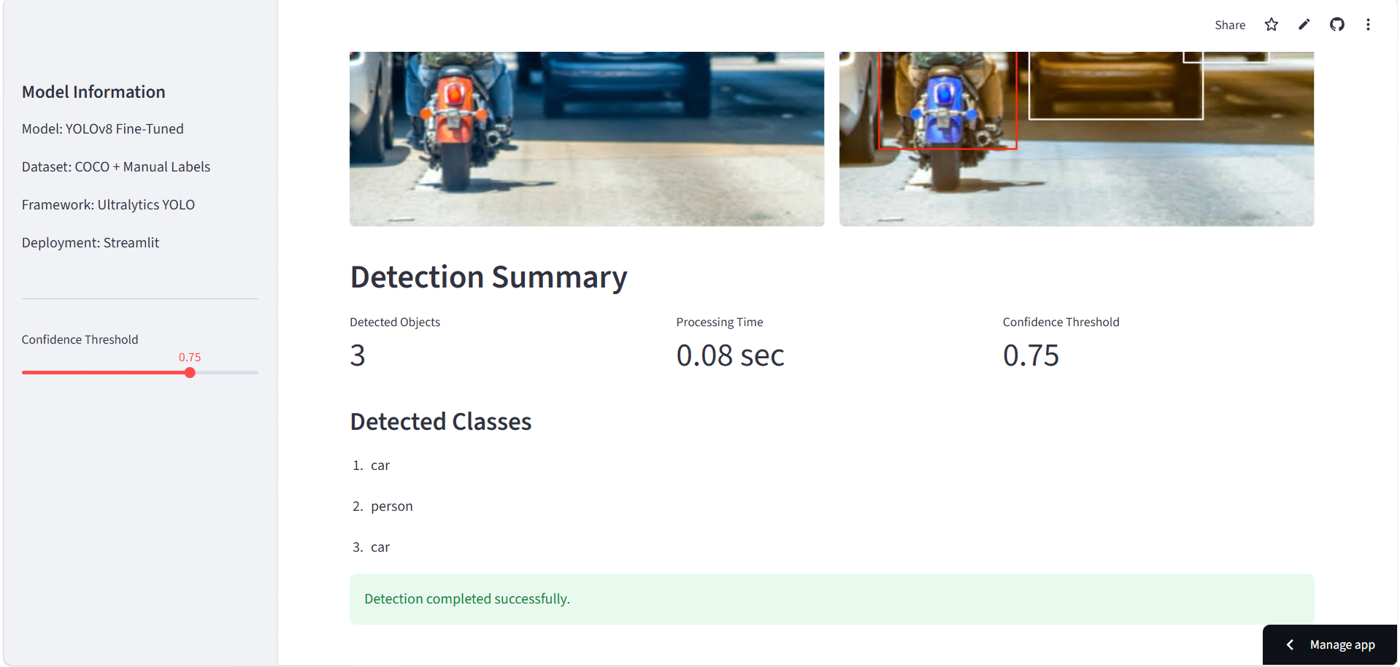
Streamlit Deployment
Features:
Upload custom image
Adjustable confidence threshold
Real-time object detection
Interactive web interface

Slide 13
Project Deliverables
GitHub Repository Jupyter Notebook Trained YOLOv8 Model Streamlit Deployment Presentation Demo Video

Slide 14
Challenges
1-Challenges Faced
Large dataset size
GPU computational limitations
Label format conversion
Mixed annotation sources
Training time optimization

Slide 15
Conclusion
Successfully built end-to-end object detection system
Compared three training strategies
Fine-tuning achieved best results
Model deployed successfully using StreamlitSlide

Slide 16
Thank You Any Questions?

